Slide 1
EFYE 2019 The use of bespoke app technology to encourage student engagement and Communication
Wil Vincent, Nick Morton
Hanifa Shah, Nathan Dewell

Slide 2
Digital Matters: The Backstory
The What Works? Student Retention and Success Project¹ recommended building a sense of belonging through activities embedded in / near the core curriculum.
At BCU, we initially developed a part-online, peer supported programme to enhance induction and support transition².
Belongingness
Preparedness
Retention & Success
Building student engagement and belonging in Higher Education at a time of change, Thomas (2012)
‘Thank you for Taking the Time to Understand’: A Critical Reflection on Peer-led Interventions in Early Experiences of Higher Education, Morton et al (2017)

Slide 3
Digital Matters: The Backstory
We already know early engagement increases confidence, and ultimately a sense of ‘belonging’ in both their course, and HE as a whole.
We also know that those who miss key information early play ‘catchup’ far beyond the first couple of weeks of class.
Ultimately there is no alternative to getting it right immediately, and making the first impression positive.
Yet, we found students chose not to interact with info provided.

Slide 4
Previous BCU Interventions
First School Focused Pre Arrival & Transition Programme, Level Up.
Small scale, small student / peer mentor ratio.
Felt very personal to students (In some cases too personal).
2011 2012 2013 2014 2015
Faculty Institutionalisation of Level Up.
More consistency in information and resources provided.
But felt less personal, and less ownership locally.

Slide 5
Previous BCU Interventions
Welcome packs sent to students, with key information & link to online resource library
Massively expensive and time consuming to produce.
Students couldn’t filter out key information: Too much ‘noise’.
Late enrolling / clearing students would miss out; feeling isolated.
Printed timetables provided: Many binned / lost within 5 minutes.
2014 2015 2016 2017 2018
Welcome Week App (As presented at EFYE 2018).
Designed to guide students though Welcome Week Experience
Designed to ‘Cut Through the Noise’.
85% of students downloaded app, over 500,000 data points.

Slide 6
Previous BCU Interventions
Launch of University Assistant App within Faculty of Computing, Engineering & Built Env.
Launched to approximately 1250 first year students, across 4 major subject areas.
Subsequently launched to 2nd and 3rd year students, to allow for comparison.
Incorporates built in chat feature, for communication to Faculty Student Advisors (SSAs).
Welcome Week App repurposed as an Assignment Planner pilot.
2016 2017 2018 2019 2020
Launch of Backloop, an innovative student feedback >> response system.
Research completed on 1 year of using University Assistant & Backloop.
Over 2 Million data points to analyse use & student interaction.
Senior Leadership ‘Buy in’ for University wide scheme.
Planning to ‘Scale Up’ system for a more diverse student population.

Slide 7
Key Issues Identified From Previous Experiences
Physical packs are expensive to send, and rely heavily on:
postal services delivering on time and in one piece.
and students responding to the info provided to them.
Meanwhile students often search for information online, and take Facebook / Twitter posts of others as fact.
Students are ‘tech driven’ and rely on phones as a life scheduler and information provider.

Slide 8
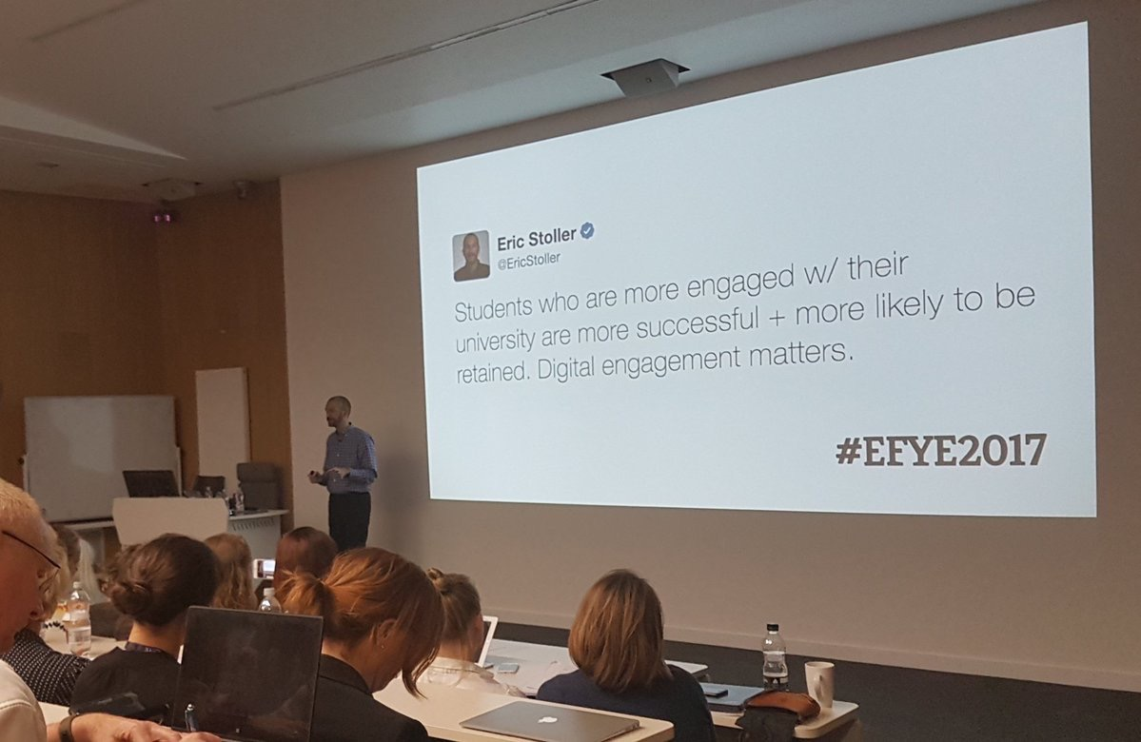

Slide 9
Key Issues Identified From Previous Experiences
We spend lots of time getting the first messages right, then ‘Fizzle out’ over the year.
We expect students to remember the myriad of information we provide them at induction.
EVERYTHING ABOUT
Joining University & Regulations
The Course & Assignments
Library & IT & Support Services
Academic Success
Professional Bodies
AND SO ON!
+ Over 50 Emails from External Companies, Students Unions Etc
Generic University Information
‘Come Study With Us!’
Early Check Ins
Information & guidance flows off
OPEN DAY RESULTS DAY WELCOME WK SEMESTER 1 SEMESTER 2

Slide 10
Key Issues Identified From Previous Experiences
Controlling information across various university systems is tough:
Intranets are centrally controlled, but by whom?
VLEs are locally controlled, but can be out of date.
Navigation is almost always a nightmare.
Students are forced to navigate information, through terminology they may not understand / know.
Students are increasingly used to easy access to information, on demand, regardless of time of day.
Quality of software is important. People won’t access unreliable solutions.

Slide 11
Students are Technophiles.
V
(Mainly)
A Smartphone in every pocket
Every student has (or can affordably get) a Smartphone. Adoption amongst teenagers > 96% in 2018¹
Smartphones are the device of choice
Smartphones are the #1 choice for 16-25 year olds. Students want their apps, data, and support on-the-move²
Smartphones where stuff happens
Screen-time can significantly exceed contact hours³. Students live on their Smartphones, you need to be there too
Deloitte: Global mobile consumer survey 2018, the UK cut
Office for National Statistics: Internet access – households and individuals, Great Britain: 2018
Ofcom: The communications market, 2018

Slide 12
Collaboration and Sharing
email
Assistant
email
FB groups
FB groups
Corporate focus and control
MS teams
Student / Faculty focus and control
Backloop
Survey Monkey
Office 365
Office 365
Twitter feed
Twitter feed
Moodle App
Moodle App
Moodle App
What Students Actually Use
Student / Staff Intranet
Excel Trackers
iBCU
App
Student / Staff Intranet
iBCU
App
VLE
Faculty KPIs
VLE
What We Encourage / Expect Students to Use
Student Records
Staff Records
Transactional / Systems of Record
Locally deploy standard IT tools
Priority IT focus

Slide 13
University Assistant
Created in partnership with Tandem Labs
Reduces reliance on IT expertise, hosting & application backend management.
Allows BCU to focus on content curation & management.
Designed to engage students on their terms.
Delivered through iOS / Android Applications.
Interacted in ways that are already ‘the norm’ to young people.

Slide 14
University Assistant
When you engage students on their terms, you increase satisfaction, you increase retention, and you can provide support when it's most needed.
University Assistant makes it quick and easy to do exactly that.
Engage every student
Share high quality, targeted content that cuts through the noise and nudges behaviour.
Support students where they are
Asking for help shouldn’t be complicated or embarrassing. Provide personal help and support in-the-moment.
Measure your effect
Listen to students, measure their engagement, and respond in real-time to themes, trends and areas of concern.

Slide 15
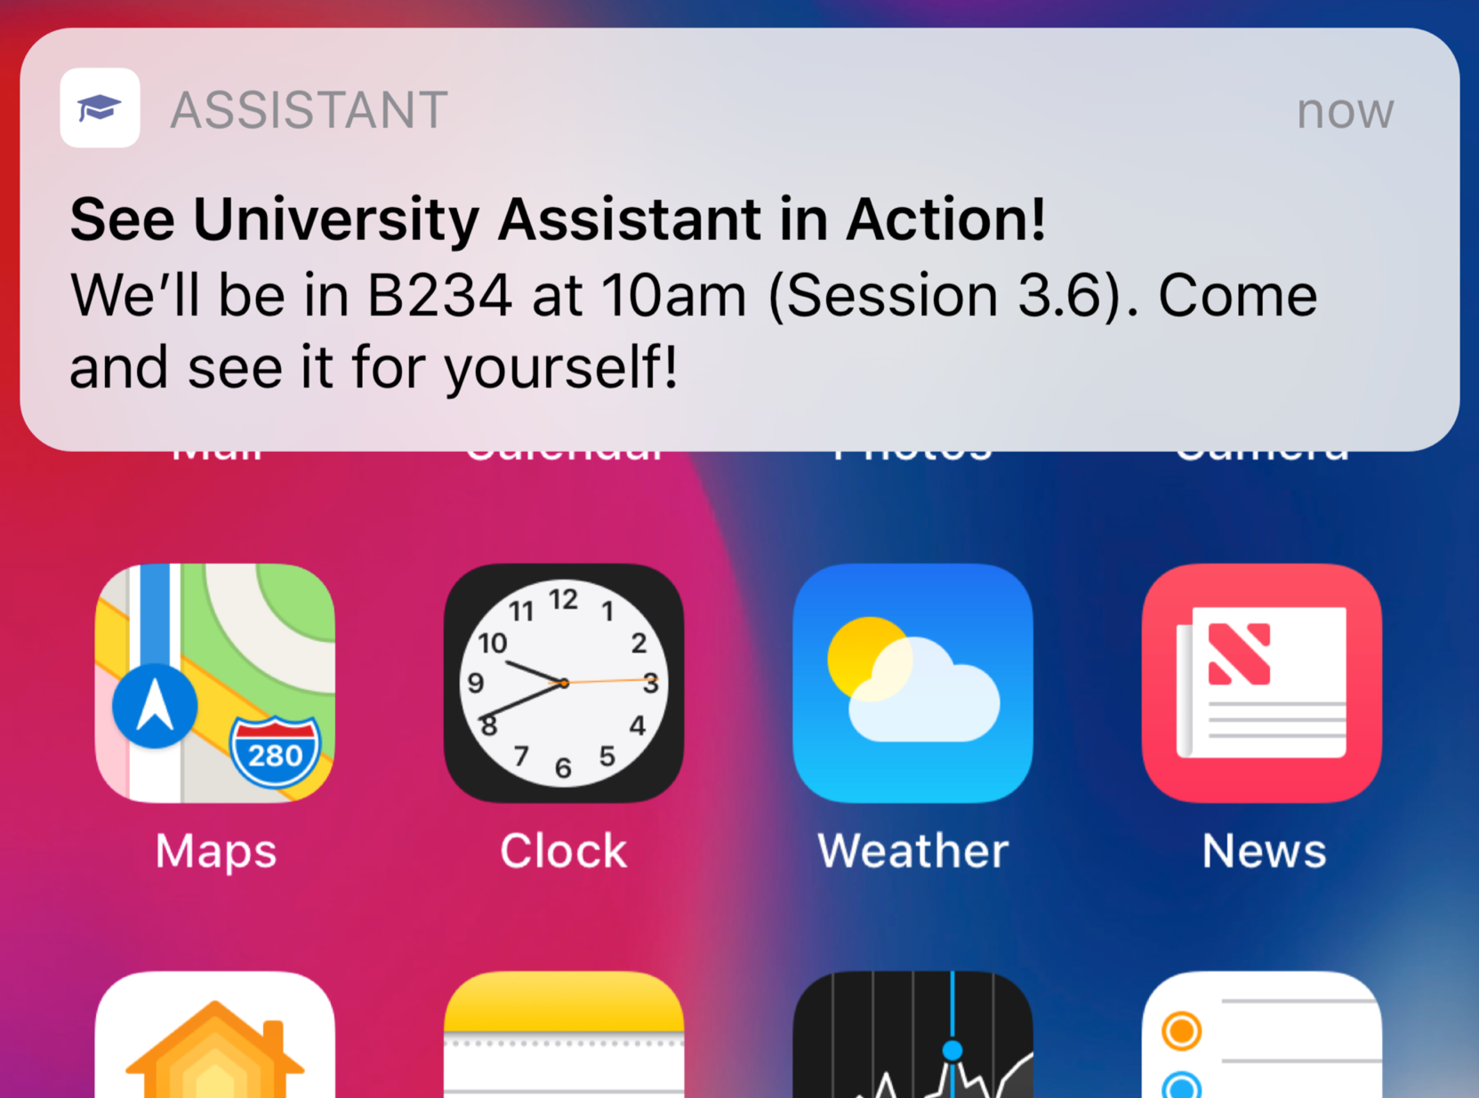
University Assistant
Engage every student
Share high quality, targeted content that cuts through the noise and nudges behaviour.
Content curated by student advisor team, with specific emphasis on:
Tone of language, being ‘student friendly’, not corporate.
Providing appropriate, relevant, rich media responses.
Content targeted to specific groups of students
By year group (The student journey).
By course group (This relates to me personally).
Any combination of these (Specific Tutor / Support Groups, International, etc)
Content made ‘accessible’ to those with disabilities.

Slide 16
University Assistant
Engage every student
Share high quality, targeted content that cuts through the noise and nudges behaviour.
Displayed in a style familiar to students:
Facebook Timelines.
Buzzfeed news scrolling.
Notifications to remind & alert of important news / changes
Ability to track engagement & feedback:
Student click-through to content from app.
3 point scale, emoji based feedback on article.

Slide 17
University Assistant
Support students where they are
Asking for help shouldn’t be complicated or embarrassing. Provide personal help and support in-the-moment.
Facebook messenger style ‘Chat function’.
Manned from 9AM – 5PM Mon – Fri, in and out of term time.
Designed to be communicated in ‘normal’ language, rather than the ‘formality’ of emails / appointments.
No question is ‘Too small’. By responding to many, smaller queries, ability to stop students reaching crisis point.

Slide 18
University Assistant
Support students where they are
Asking for help shouldn’t be complicated or embarrassing. Provide personal help and support in-the-moment.
Responded to by Student Success Advisor Team
Recent graduates of BCU.
Have ‘lived’ the student journey on our courses.
‘On the ground’ with knowledge of all university functions. Triage / signposting experts.
Responses seem personal to students, even if this is not always the case in practice! (Model / tailored responses).

Slide 19
University Assistant
Support students where they are
Asking for help shouldn’t be complicated or embarrassing. Provide personal help and support in-the-moment.
App chat seen as a ‘safe space’, removing some of the fears of prejudice or ‘not being taken seriously’.
Allows students to ‘say the unsayable’ or things that they may struggle to say in person, by phone / email.
Students able to ‘leave an issue’. 40% of our contacts came out of working hours.
In effect, we are lowering communication thresholds.

Slide 20
University Assistant & Backloop
Measure your effect
Listen to students, measure their engagement, and respond in real-time to themes, trends and areas of concern.
Use real-time data to drive decisions
Are events being missed? Are key messages getting through?
Precisely targeting content
Focused, timely, hyper-relevant material e.g. for individual personal tutor groups.
Curated ‘best-of’ highlights.
Nudging student behaviour
Sparingly used, in-app notices and notifications direct to phones are a powerful (re)engagement tool.

Slide 21
University Assistant & Backloop
Measure your effect
Listen to students, measure their engagement, and respond in real-time to themes, trends and areas of concern.
Backloop acts an online feedback mechanism, sent to students once a fortnight.
Key purpose is to ‘check in’, and ask thought provoking questions, relevant to the student journey.
These ‘check in’s allow students to provide feedback, allowing:
Them to get things ‘off their chest’.
Teaching teams to be aware of any issues that arise.
Student advisors to initiate and close a meaningful feedback loop.

Slide 22
Our Outcomes
97% adoption rate across 1st year students.
Success driven through embedding into transition & induction.
App made the default (But not only) method of communicating events, change and information during Welcome Week.
80% reduction in email and phone traffic during student transition into university, and Welcome Week.
210 student queries responded to before classes commenced
77,000 article impressions across Welcome Week.

Slide 23
Our Outcomes
We noticed a shift in student app usage and consumption throughout first year.
Transitional Phase
Mixture of curiosity and scheduling: Wants to know what’s happening, when, and where as adjusting to being a HE Student.
In Semester Phase
‘Checking in & Checking out’: Consuming content seen as useful & relevant. Asking questions when they arise.
Assessment Periods
‘I have this issue’: Ultra specific, personal issue affecting a student, at a potential point of crisis in their studies / life.

Slide 24
Our Outcomes
A lot of our work required re-thinking the way we communicated with students:
For first years, having not been exposed to other systems, this method of interaction became ‘the norm’.
This compares with other students, who had embedded methods of finding information and contacting key people.
Despite this, where 2nd / 3rd year students have downloaded the app, we find their consumption patterns shift.
Subject discipline seems not to be a barrier to uptake and usage.

Slide 25
Our Outcomes
Importantly, we have found Semester 1 student withdrawals have decreased by 40% on 2017/8 (21% for 1st Years)
Avoiding the Cliff Edge
By encouraging students to contact us over the potentially ‘nonsensical’, we remove barriers and reduce students hitting crisis point.
Notification VS Email
When students disengage, emails are often ignored. A carefully curated app notification can ‘nudge’ students to check in.
Less Searching For X
‘I have this issue’: Ultra specific, personal issue affecting a student, at a potential point of crisis in their studies / life.

Slide 26
What We’ve Learned
Early Adoption Is Everything
Working with students prior to induction and commencing studies aids curiosity, but also helps embed behaviours whilst other distractions are lower.
This Isn’t Just Another Thing To Try And Aid Engagement
Students won’t stop using smartphones, and their consumption habits will likely become more focused around app based information consumption. Meeting them where they are is critical.
There’s a Fine Line Between Nudging and Nagging
Bombarding students with notifications and content isn’t how they consume information. Balance is important, and like the boy who cried Wolf!, you need to make sure the important moments are seen as such.

Slide 27
What We’ve Learned
Chat Responsiveness: It’s Make or Break
For a student, this may be the ‘one time’ they seek out support. Even if it’s not an immediate resolution, letting them know ‘you’re on it’ puts them at ease, and will aid in future expectations.
These Are Not One Off, Solitary Questions
Over time, expect students to share and raise issues that are fundamental to their wellbeing, continuation, and performance. These can be spotted and escalated, and we can have more meaningful conversations.
It’s Not Always About Publishing New Content
whilst new content is required, you can reuse and republish articles, videos and collections and target them to different student groups at different times, tailored to their specific student journeys.

Slide 28
Final Thoughts
“Our students are always on the move, and always on their smartphones. University Assistant give us a fantastic engagement channel that’s always within students’ reach.
It helps us target our communications, it provides an intuitive support channel, and provides the leadership team with real-time analytics - so we can react and adapt to student feedback and insight in a more agile way.”
—Professor Hanifa Shah
Executive Dean
Birmingham City University

